Slide 1

PixelStorm GAME

Slide 2

Table of Contents

Slide 3
01
Our Team

Slide 4
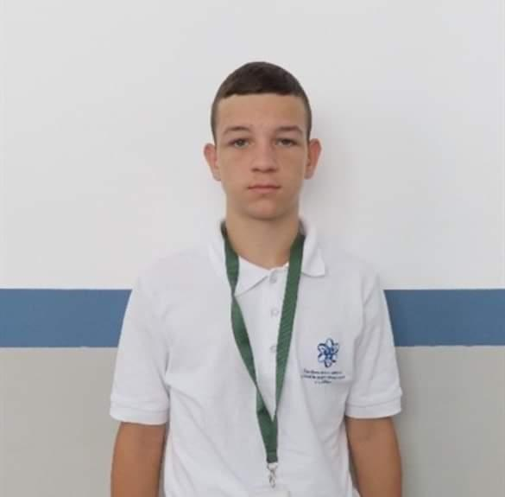
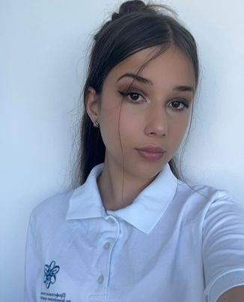
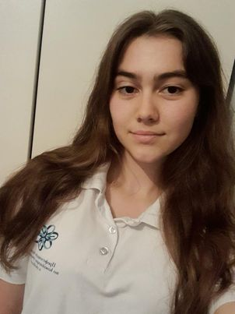
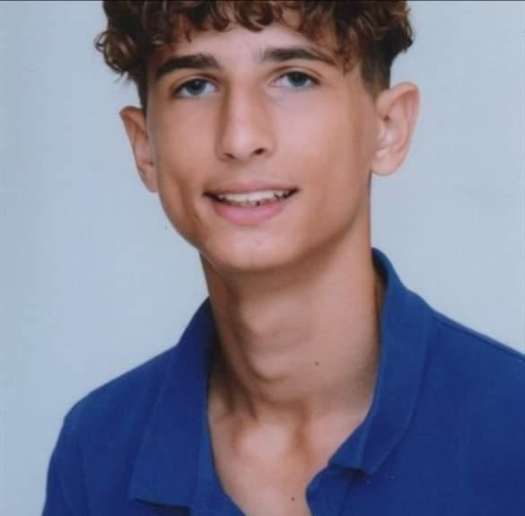
Our Team
SCRUM TRAINER
FRONTEND DEVELOPER
BACKEND DEVELOPER
DESIGNER
Ivan Ivanov
Valeria Vulchanova
Desislava Peeva
Teodor Despotov

Slide 5
02
Our Idea

Slide 6

Our game is for students from 5th to 7th grade and the idea of ​​the game is to make learning math fun and interesting through educational games.

Slide 7
03
Used Programs

Slide 8










Slide 9
Let’s jump to the project!

